Slide 1
3D Graphics and Animation
3D Transformation Matrix

Slide 2
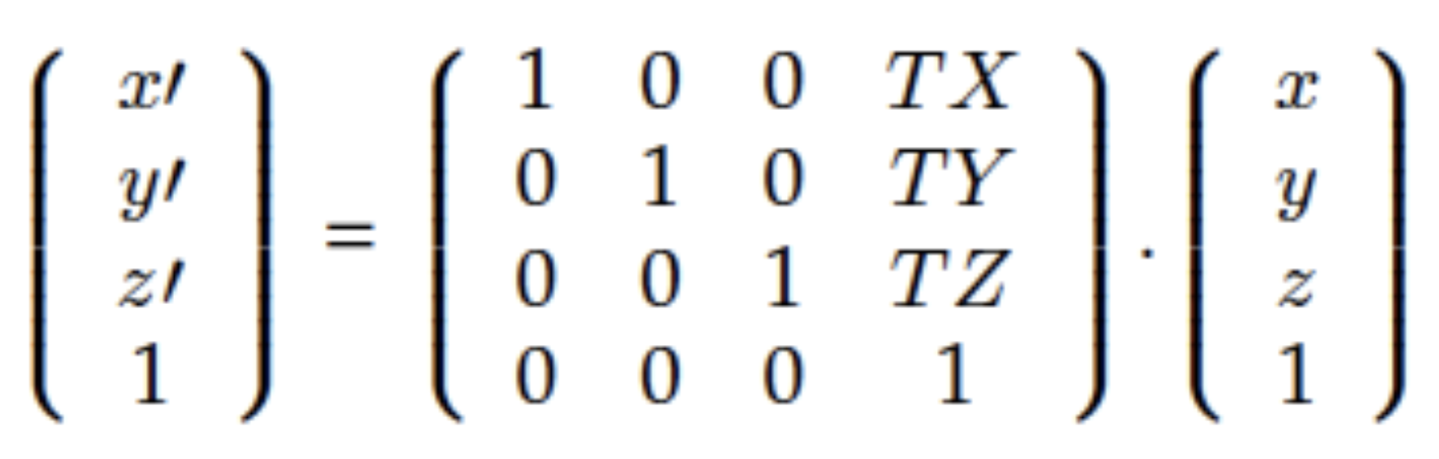
3D Translation
3D Translation is an extension of 2D Translation

Slide 3
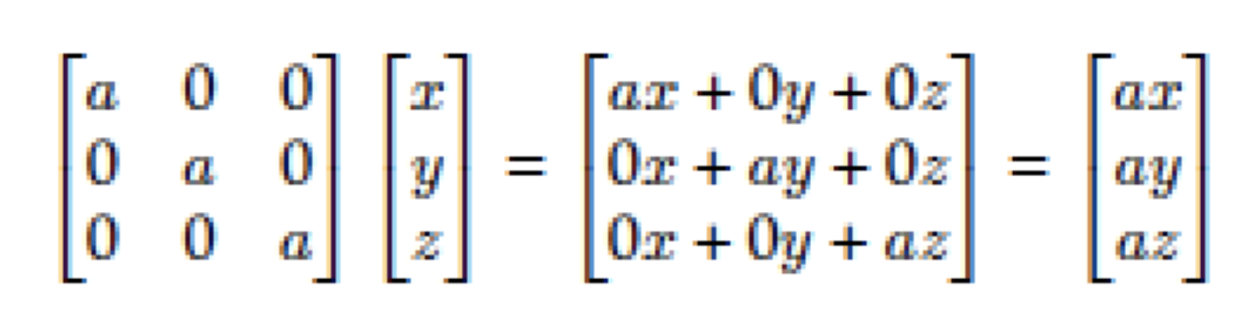
3D Scale
Scale the vector by a
Become larger if a is greater than 1 and smaller if a is less than 1

Slide 4
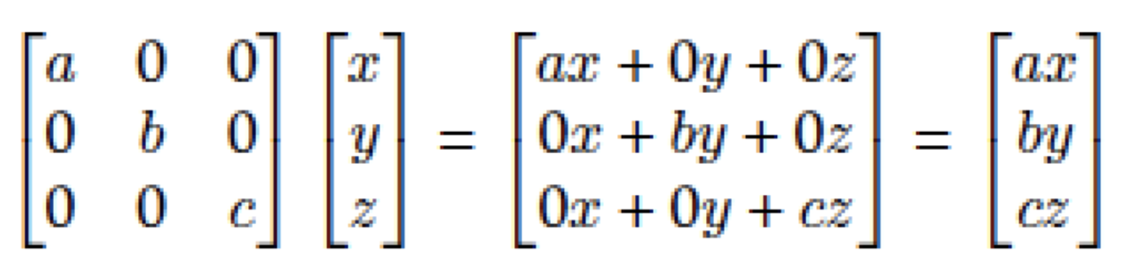
3D Scale
Non uniform scale :
Each direction is scaled differently
Resulting in a squash or stretch

Slide 5
3D Rotation
Rotation in x y or z axis..
Need consider are about each of the coordinate axes—x , y and z .
Each axis has its’ own rotation matrix.

Slide 6
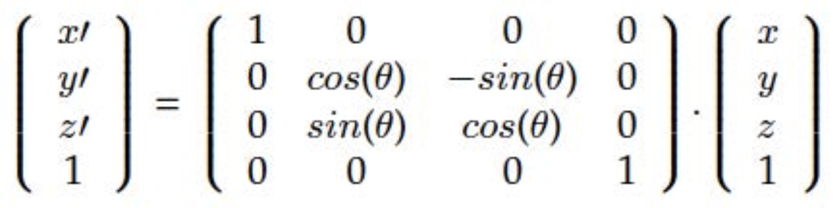
3D Rotation
x-axis rotation

Slide 7
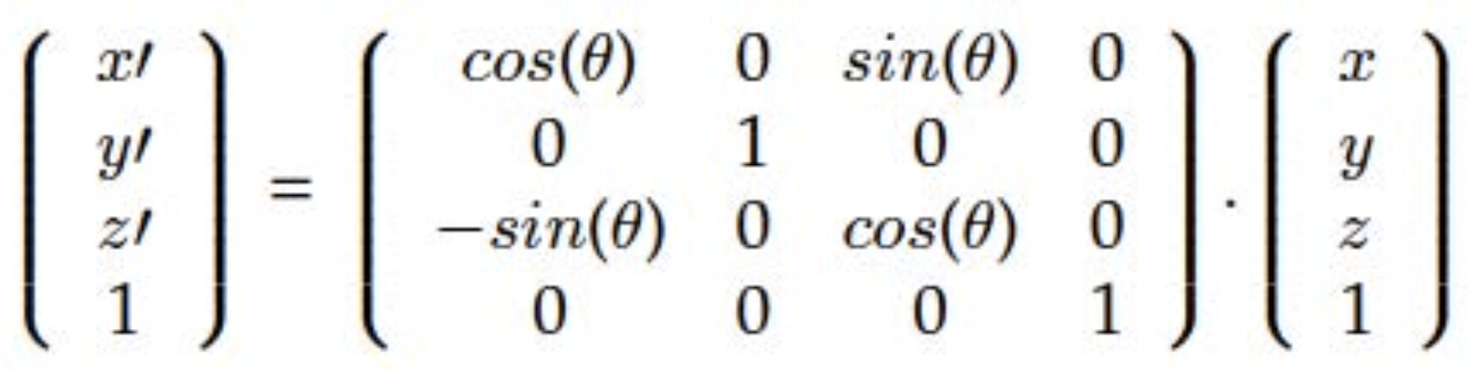
3D Rotation
y-axis rotation

Slide 8
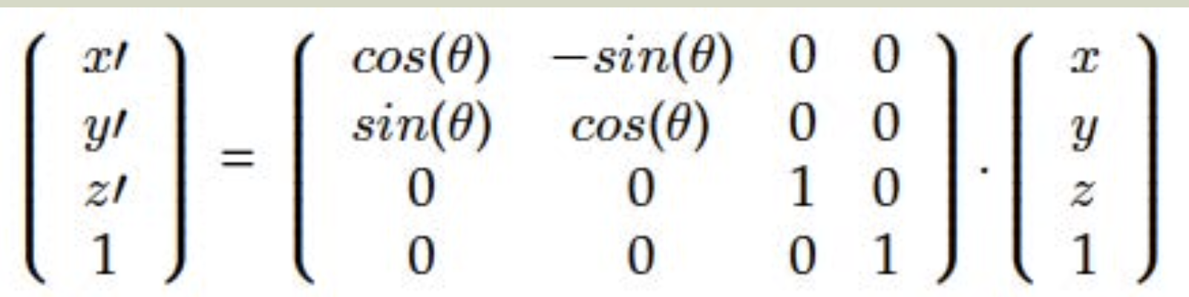
3D Rotation
z-axis rotation

Slide 9
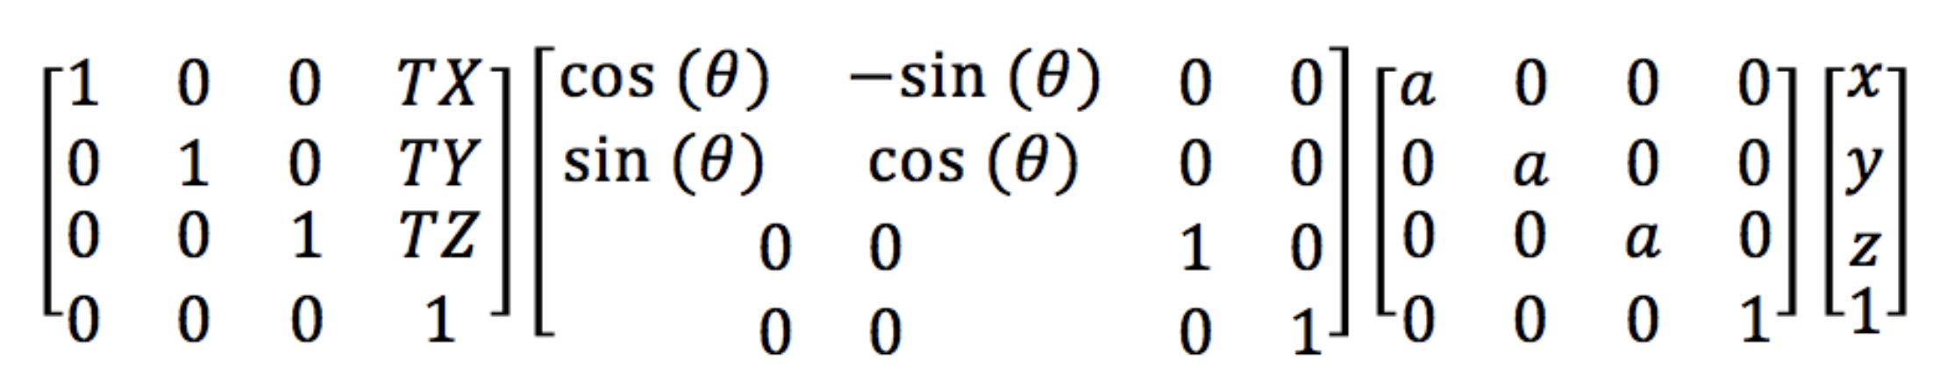
Combing Transformation
Orders are important
Perform a scale, rotation and translation on a vector like this :

Slide 10
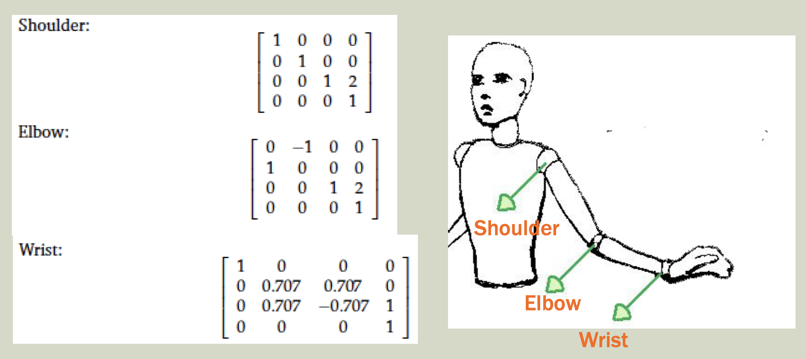
Exercise
The shoulder, elbow and wrist joint of a skeleton have the following transform matrices given below. What is the position of the wrist? Assume the base is at [1,1,1]

